Slide 1


MOTION DE-BLURRING
IN FREQUENCY DOMAINS
TEAM MEMBERS
TEJAS GUDURU
SIDDHI DUBE
SAKSHI MANTRI
MAYUR DEVADIGA

Slide 2
Table Of Contents
01
02
PROBLEM STATEMENT
OBJECTIVES OF PROJECT
03
04
METHODS AND TECHNIQUES
WEINER FILTER
05
06
MACHINE LEARNING
RESULTS
07
08
COMPARISON
APPLCATIONS
FUTURE ENHANCEMENT
09
10
CONCLUSION

Slide 3
Problem Statement
  The quality of digital images are often degraded by various types of blurs, among which motion blur caused by camera movement is particularly common.
  This project aims to address the challenge of restoring images that have been degraded by linear motion blur.

Slide 4

Objectives of the Project
The specific objectives of the project are:
  Simulate Motion Blur
  Add Guassian Noise
  Implement Wiener Filtering
  Evaluation

Slide 5
Methods and Techniques
GUI
DEVELOPMENT
AND INTEGRATION
IMAGE PROCESSING
TECHNIQUES
FOURIER
TRANSFORMATIONS
MACHINE LEARNING
TECHNIQUES
  Motion Blur Simulation
  Gaussian Noise Addition
  Wiener Filtering
  Discrete Fourier Transform
  Inverse Discrete Fourier Transform
  Tkinter
  Convolution Neural Network
(CNN)

Slide 6
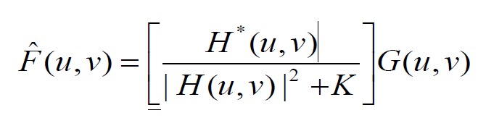
Weiner Filter
The Wiener filter is a popular method used for image restoration in the presence of noise. It's particularly useful when the characteristics of the noise and the original image are known or can be estimated. The Wiener filter aims to minimize the mean square error between the estimated image and the original image.

Slide 7
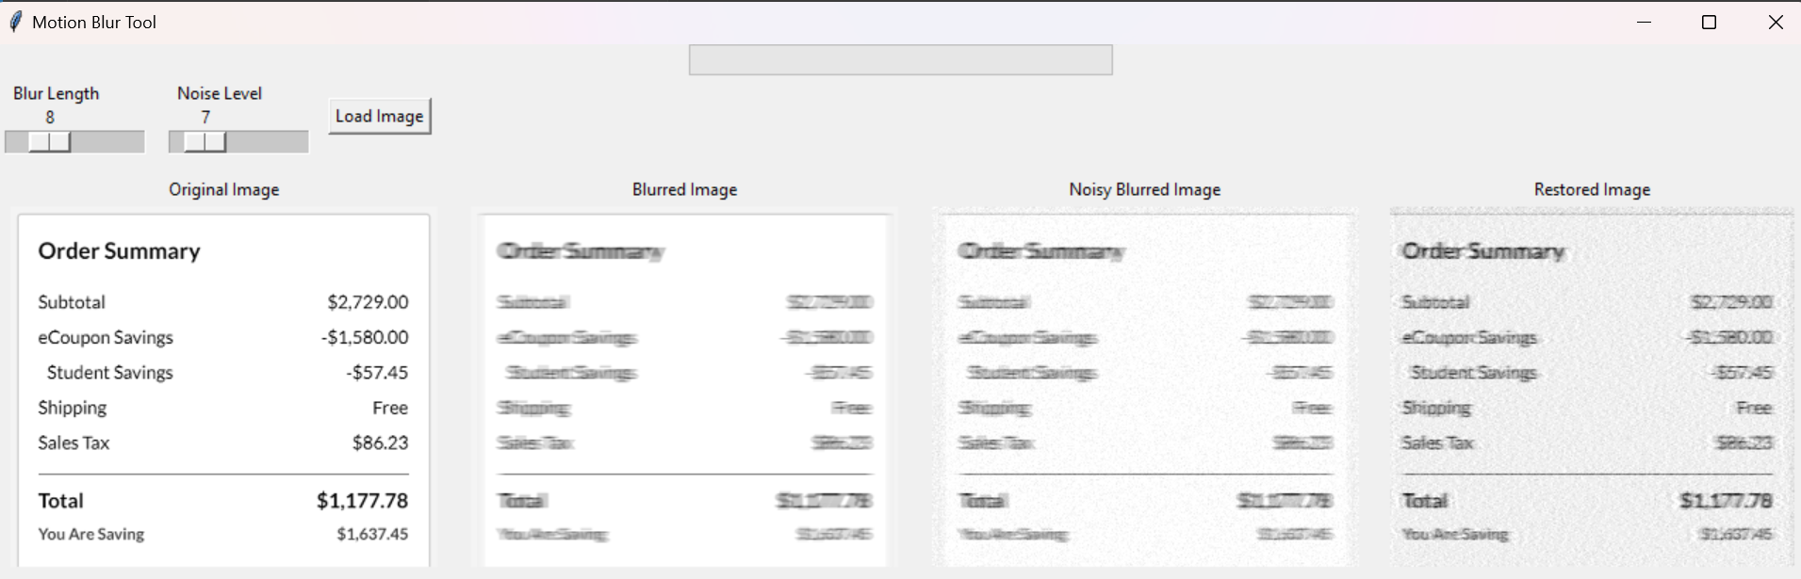
Results for Weiner Filter

Slide 8
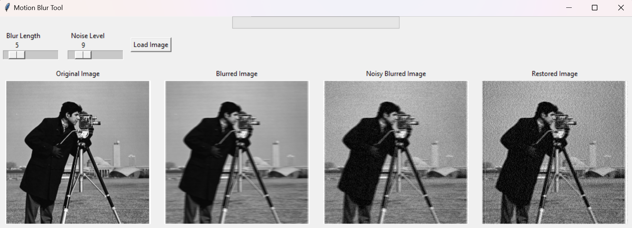
Results for Weiner Filter

Slide 9
Machine Learning in Image Restoration
  Machine Learning Overview : A branch of artificial intelligence where algorithms improve their performance by learning from data, without explicit programming.
  Application to Image Restoration : Trains on datasets of degraded and restored images to learn patterns for effective image restoration.
  Enhanced Accuracy and Efficiency : Provides superior accuracy in restoring images by learning complex relationships and improves processing efficiency over traditional methods.
  Widespread Adoption and Impact : Adopted broadly in academic and professional fields, leading to groundbreaking improvements in digital image processing.

Slide 10
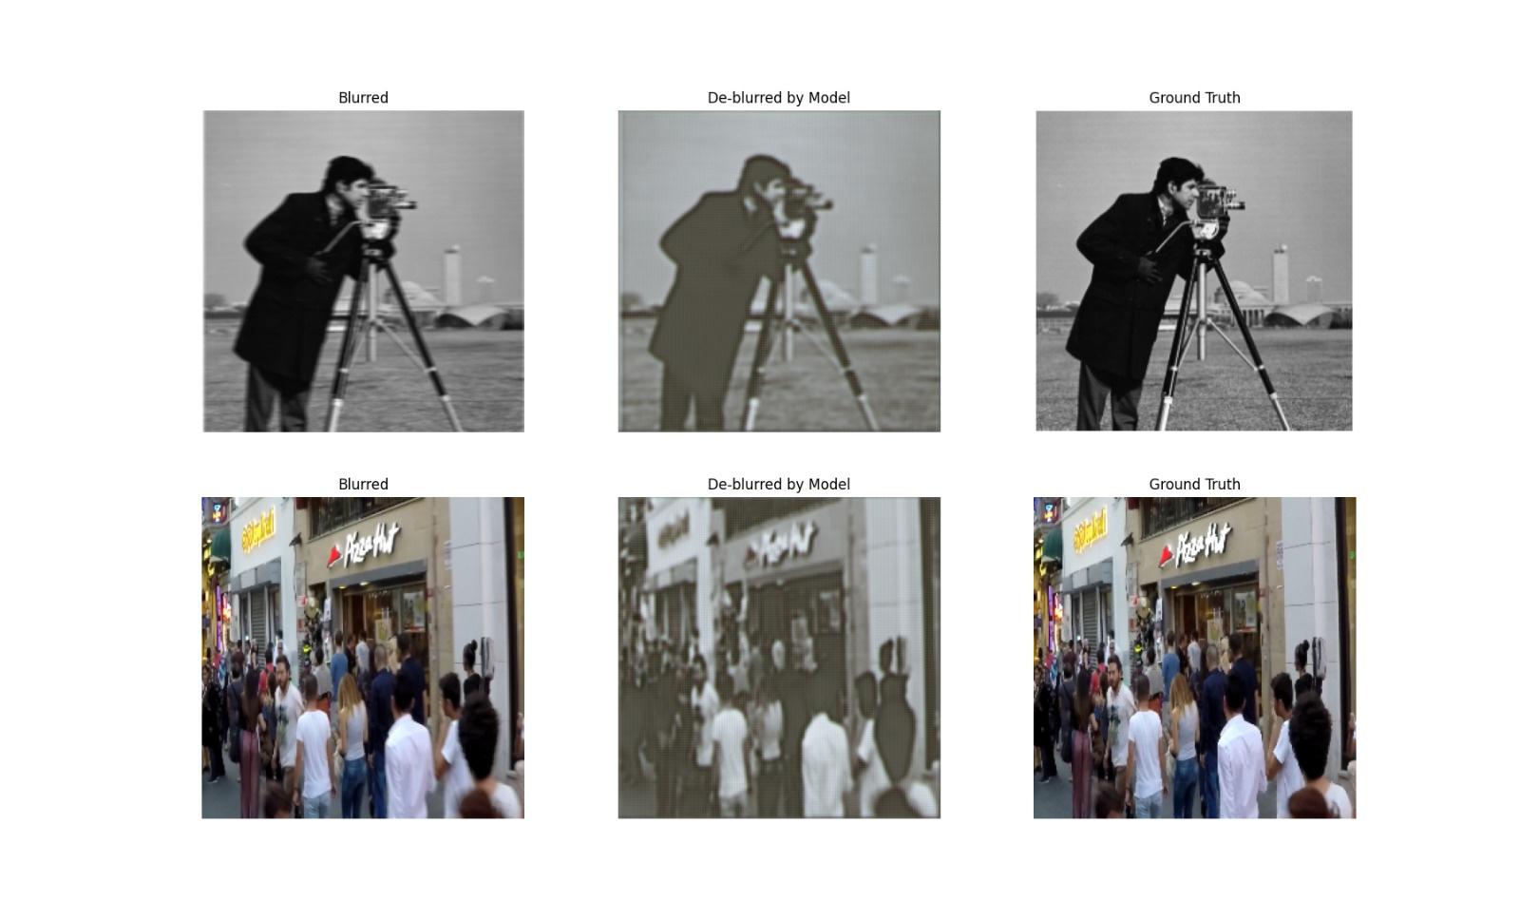
Results for Machine Learning

Slide 11
Feature | Wiener Filter | Machine Learning Models
Principle | Statistical - minimizes mean squared error | Machine learning - learns from data
Limitations | Less effective for non-linear/unknown degradation, requires precise noise estimation | Requires large datasets, significant computational resources
Performance | Less effective for complex degradation | More effective for complex degradation
Efficiency | Computationally efficient | Computationally expensive
Use Case | Controlled environments (astronomical imaging, medical imaging) | Dynamic, real-world applications (consumer photography, surveillance)

Slide 12




Applications
VIDEO-SURVELLANCE
MEDICAL DIAGNOSIS
ACADEMIA

Slide 13

Future Enhancement
USER INTERFACE IMPROVEMENTS
ADAPTIVE FILTERING TECHNIQUES
HARDWARE ACCELERATION AND OPTIMIZATION
INTEGRATION OF DEEP LEARNING MODELS
COLLABORATIVE AND CLOUD-BASED PROCESSING
ROBUSTNESS
AND GENERALIZATION
  Interactive Feedback System
  Batch Processing Capabilities
  Content-Aware Processing
  Multi-Scale Approaches
  FPGA/ASIC Implementation
  Efficient Algorithm Design
  Advanced Neural Network (CNNs/GANs)
  Transfer Learning
  Cloud Integration
  Collaborative Filtering
  Handling blurred image
  Noise Model Enhancement

Slide 14
Conclusion
  This project not only enhances understanding of fundamental image processing challenges but also provides a practical toolkit for experimenting with these issues in an interactive manner.
  It’s a blend of theoretical knowledge and practical application, suitable for academic environments and beyond.

Slide 15
About us & Contributions
TEJAS
SIDDHI
SAKSHI
MAYUR
DEVELOPER
DEVELOPER
DEVELOPER
DEVELOPER
Weiner Filter and UI
Machine Learning
Machine Learning
Weiner Filter and UI

Slide 16
Thank You!

